Slide 2
Template size

Slide 3
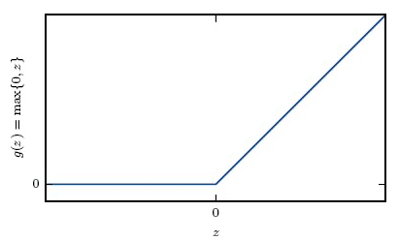
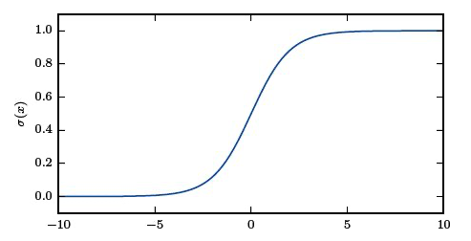
Basic components of a neural network
input
Hidden layers
output
What happens in a single epoch:
Activation
function
Forward pass
Backward pass
Update
…
…
…
width
depth
Relu
Sigmoid

